Slide 1
LBC, Session 1
Introduction to Programming

Slide 2
Objectives
Differentiate between Command, Program and Software
Explain the beginning of C
Explain when and why is C used
Discuss the C program structure
Discuss algorithms
Draw flowcharts
List the symbols used in flowcharts
LBC/Session 1
‹#›

Slide 3
Software, Program and Command
Software
Program 1
Program 2
Commands
Commands
Commands
LBC/Session 1
‹#›

Slide 4

The beginning of C
BPCL – Martin Richards
B – Ken Thompson
C – Dennis Ritchie
LBC/Session 1
‹#›

Slide 5
Application areas of C
C was initially used for systems programming
A system program forms a portion of the operating system of the computer or its support utilities
Operating Systems, Interpreters, Editors, Assembly programs are usually called system programs
The UNIX operating system was developed using C
There are C compilers available for almost all types of PC’s
LBC/Session 1
‹#›

Slide 6
Middle Level Language
High Level Language
C
Assembly Language
LBC/Session 1
‹#›

Slide 7
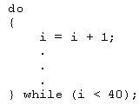
Structured Language
C allows compartmentalization of code and data
It refers to the ability to section off and hide all information and instructions, necessary to perform a specific task, from the rest of the program
Code can be compartmentalized in C by using functions or code blocks.
LBC/Session 1
‹#›

Slide 8
About C
C has 32 keywords
These keywords combined with a formal syntax form a C programming language
Rules to be followed for all programs written in C:
All keywords are lowercased
main()
{
/* This is a sample Program*/
int i,j;
i=100;
j=200;
:
}
C is case sensitive, do while is different from DO WHILE
Keywords cannot be used as a variable or function name
LBC/Session 1
‹#›

Slide 9
The C Program Structure-1
C programs are divided into units called functions
Irrespective of the number of functions in a program, the operating system always passes control to the main() when a C program is executed.
The function name is always followed be parentheses.
The parentheses may or not contain parameters.
main()
LBC/Session 1
‹#›

Slide 10
The C Program Structure-2
The function definition is followed by an open curly brace ({)
The curly brace signals the beginning of the function
A closing curly brace (}) after the codes, in the function, indicate the end of the function
Delimiters { ... }
LBC/Session 1
‹#›

Slide 11
The C Program Structure-3
A statement in C is terminated with a semicolon
A carriage return, whitespace, or a tab is not understood by the C compiler
A statement that does not end in a semicolon is treated as an erroneous line of code in C
Statement Terminator .... ;
LBC/Session 1
‹#›

Slide 12
The C Program Structure-4
Comments are usually written to describe the task of a particular command, function or an entire program
The compiler ignores comments.
There are two way to insert comments:
Single line:
//Comments go here
Multiline:
/*
Comments go here and here
*/
LBC/Session 1
‹#›

Slide 13
The C Library
All C compilers come with a standard library of functions
A function written by a programmer can be placed in the library and used when required
Some compilers allow functions to be added in the standard library
Some compilers require a separate library to be created
LBC/Session 1
‹#›

Slide 14
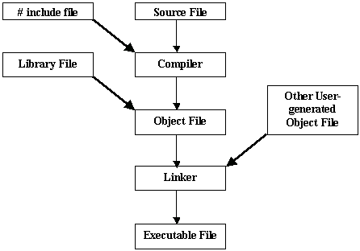
Compiling & Running A Program
LBC/Session 1
‹#›

Slide 15




The Programming Approach to Solving Problems
Algorithm is a set of steps that are performed to solve a problem. The example below describes an algorithm:
Classroom
Leaving the
classroom
Head towards
the staircase
Go to the basement
These are the steps followed when a student wants to go to the cafeteria from the classroom
Head for the
cafeteria
Cafeteria
LBC/Session 1
‹#›

Slide 16
Solving a Problem
In order to solve a problem
Understand the problem clearly
Gather the relevant information
Process the information
Arrive at the solution
LBC/Session 1
‹#›

Slide 17
Pseudocode
Is not actual code.
Is a method of algorithm - writing which uses a standard set of words which makes it resemble code
Each pseudocode starts with a BEGIN
To show some value , the word DISPLAY is used
The pseudocode finishes with an
BEGIN
DISPLAY ‘Hello World !’
END
LBC/Session 1
‹#›

Slide 18
Flowcharts
It is a graphical representation of an algorithm
START
DISPLAY ‘Hello World !’
STOP
LBC/Session 1
‹#›

Slide 19
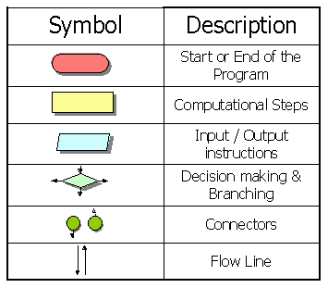
The Flowchart Symbol
LBC/Session 1
‹#›

Slide 20
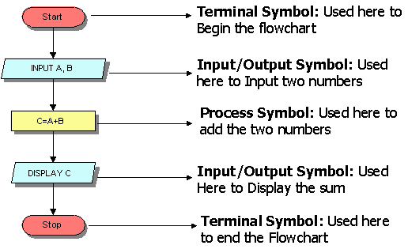
Flowchart to add two numbers
LBC/Session 1
‹#›

Slide 21
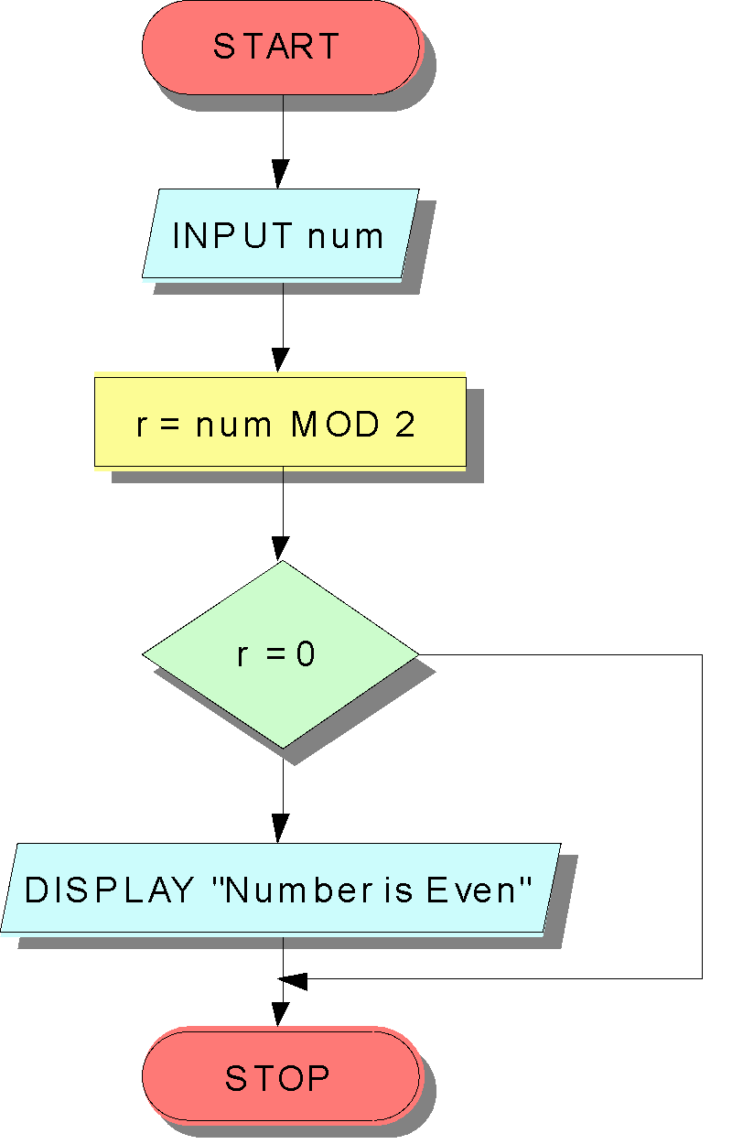
The IF Construct
BEGIN
INPUT num
r = num MOD 2
IF r=0
Display “Number is even”
END IF
END
No
Yes
LBC/Session 1
‹#›

Slide 22
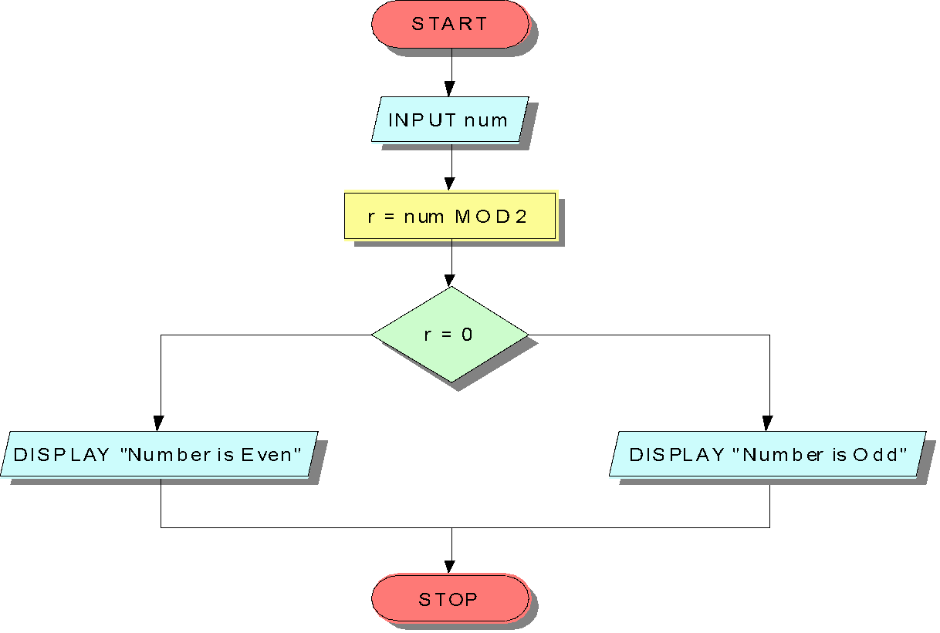
The IF-ELSE Construct
BEGIN
INPUT num
r=num MOD 2
IF r=0
DISPLAY “Even Number”
ELSE
DISPLAY “Odd Number”
END IF
END
Yes
No
LBC/Session 1
‹#›

Slide 23
Multiple criteria using AND/OR
BEGIN
INPUT yearsWithUs
INPUT bizDone
IF yearsWithUs >= 10 AND bizDone >=5000000
DISPLAY “Classified as an MVS”
ELSE
DISPLAY “A little more effort required!”
END IF
END
LBC/Session 1
‹#›

Slide 24
Nested IFs-1
BEGIN
INPUT yearsWithUs
INPUT bizDone
IF yearsWithUs >= 10
IF bizDone >=5000000
DISPLAY “Classified as an MVS”
ELSE
DISPLAY “A little more effort required!”
END IF
ELSE
DISPLAY “A little more effort required!”
END IF
END
LBC/Session 1
‹#›

Slide 25
Nested IFs-2
START
INPUT YearsWithUs
INPUT bizDone
YES
YearsWithUs >= 10
NO
DISPLAY “A Little more effort required”
NO
bizDone > 5000000
YES
DISPLAY “A Little more effort required”
DISPLAY “Classified as an MVS”
STOP
LBC/Session 1
‹#›
Notes:
Đọc thêm:
+ http://en.wikipedia.org/wiki/C_(programming_language)
+ http://www.livinginternet.com/i/iw_unix_c.htm

Slide 26
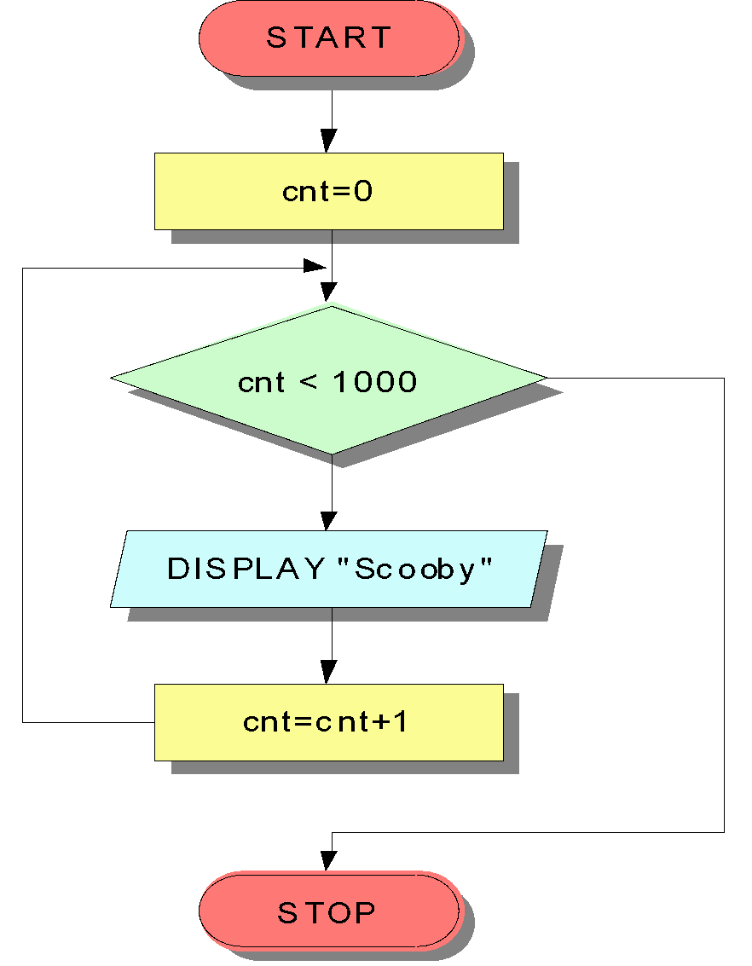
Loops
BEGIN
cnt=0
WHILE (cnt < 1000)
DO
DISPLAY “Scooby”
cnt=cnt+1
END DO
END
No
Yes
LBC/Session 1
‹#›

Slide 27
Summary
Software is a set of programs.
A Program is a set of instructions.
Code blocks, form a base of any C program.
An Algorithm is a logical and concise list of steps to solve a problem
A pseudo code is a representation of an algorithm in language that resembles code
A flowchart is a diagrammatic representation of an algorithm
The basic selection construct is an ‘IF’ construct
The iterative or looping constructs is necessary to repeat certain steps
LBC/Session 1
‹#›

